Slide 1
SAP S/4HANA

Slide 2


Slide 3
What is SAP S/4HANA?
The next version of SAP Business Suite
New code base, only supported with the SAP HANA DB
SAP S/4HANA is SAP’s next-generation business suite that enables customers to streamline data models, optimize daily business transactions, accelerate strategic decision making, and simplify with a digital core – whether you use it in the cloud or on premise.
S/4HANA themes
Renewed interface with Fiori UX
Simplified structure with SAP HANA

Slide 4
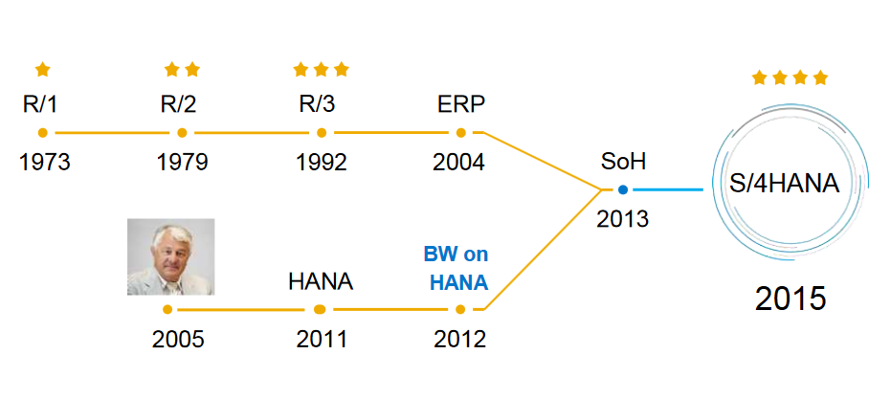
A truly new product

Slide 5
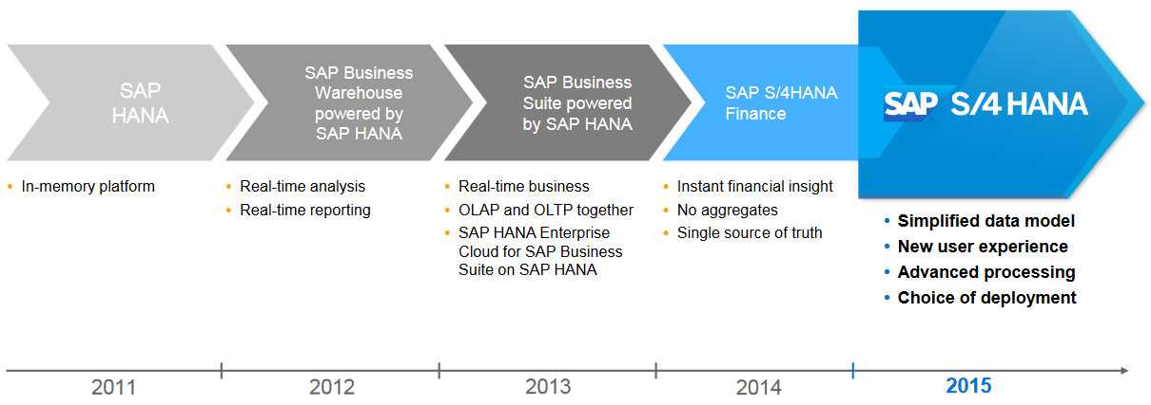
SAP HANA, great simplifier for enterprise applications

Slide 6
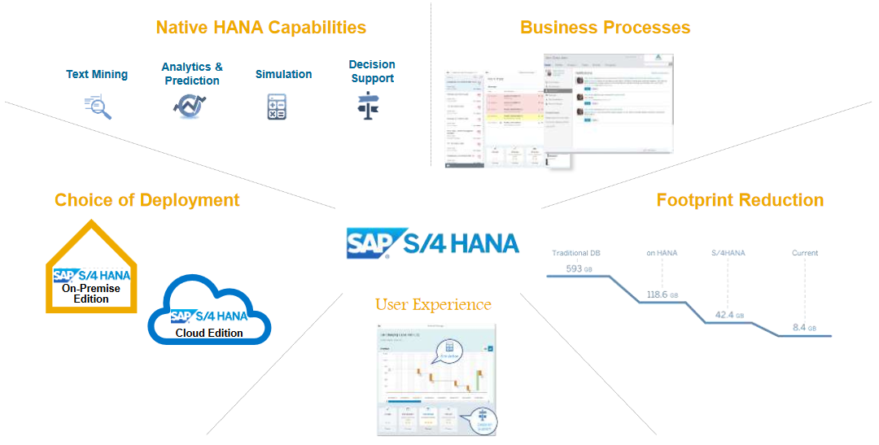
S/4 HANA Pillars

Slide 7
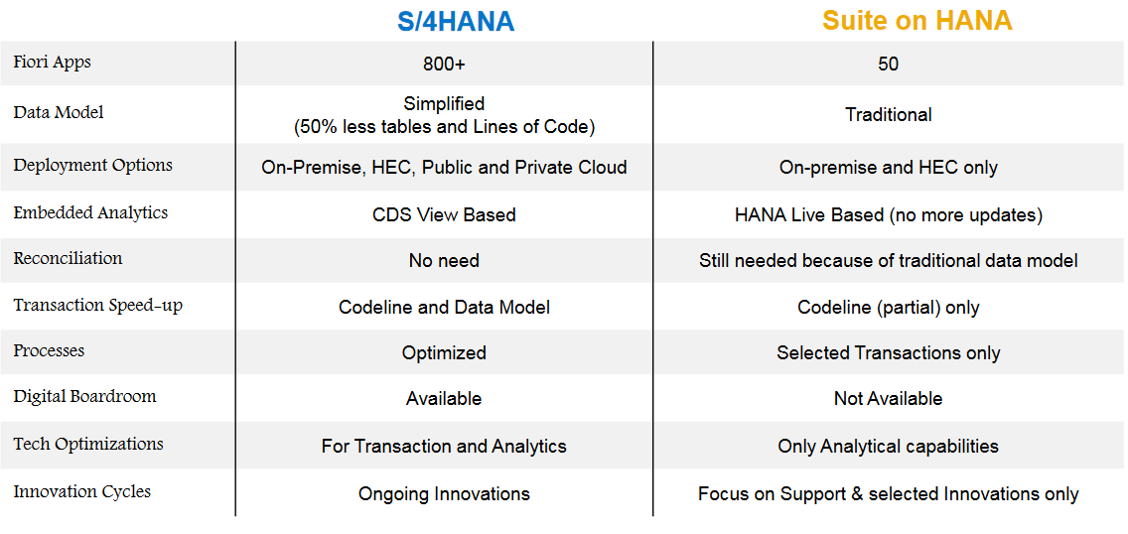
What are the differences between Suite on HANA and S/4HANA?

Slide 8
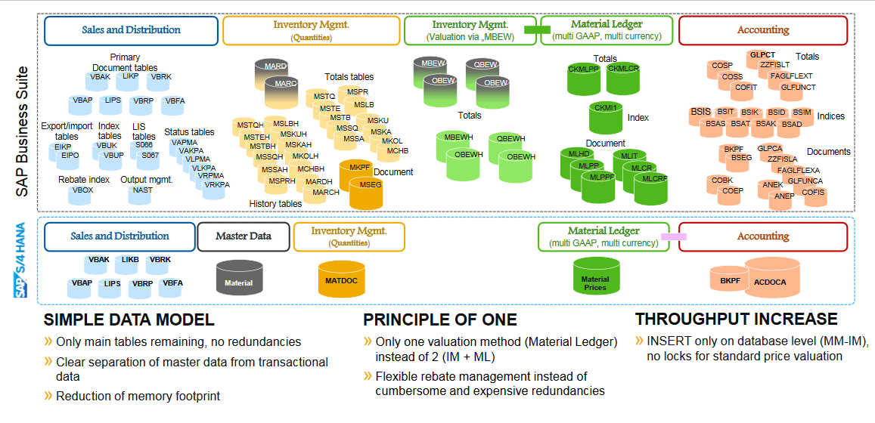
A Completely New Data Model

Slide 9
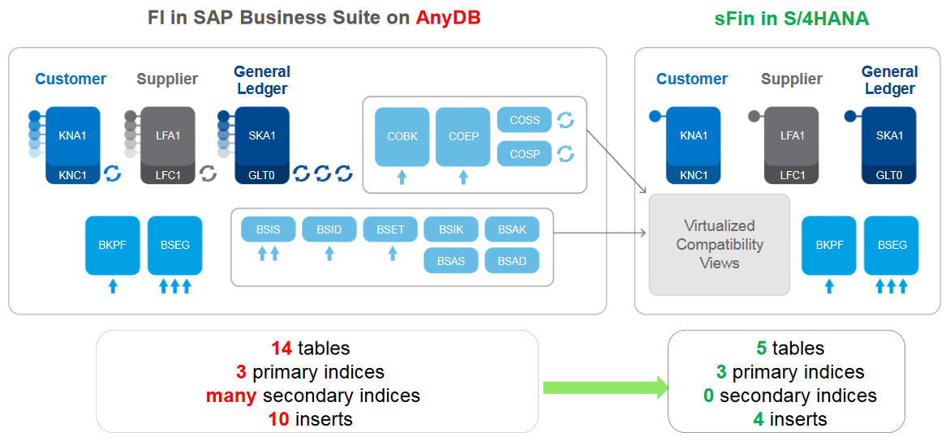
S/4HANA Example of dramatic simplification: Finance - invoice posting

Slide 10
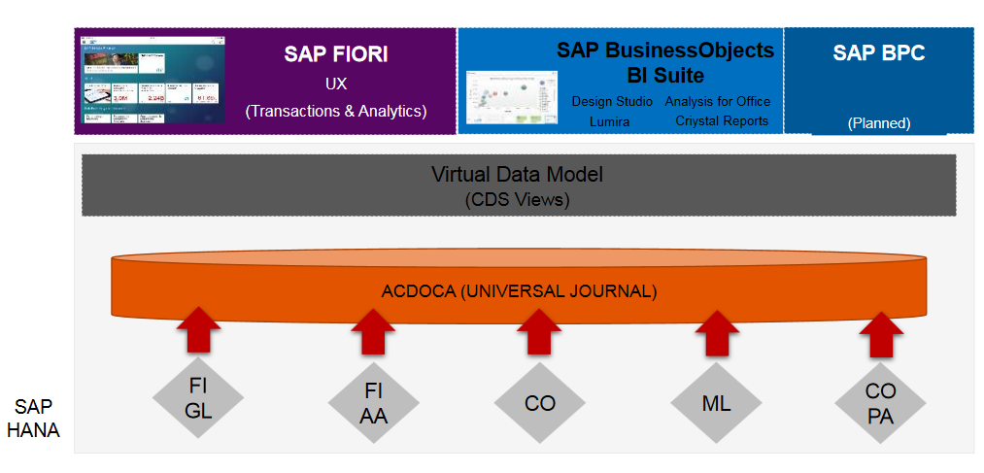
A single copy of data – one source of truth

Slide 11
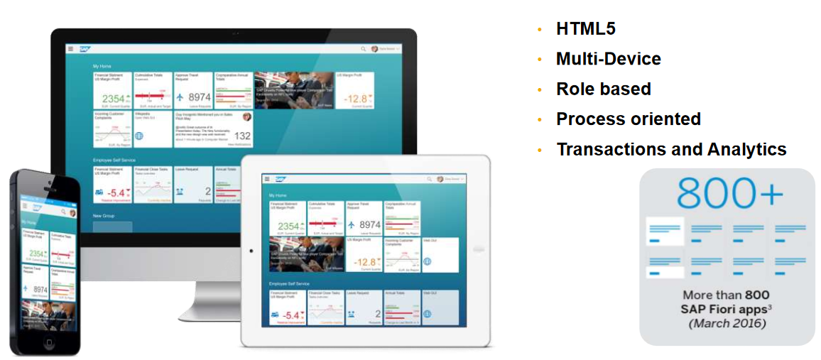
New user experience

Slide 12
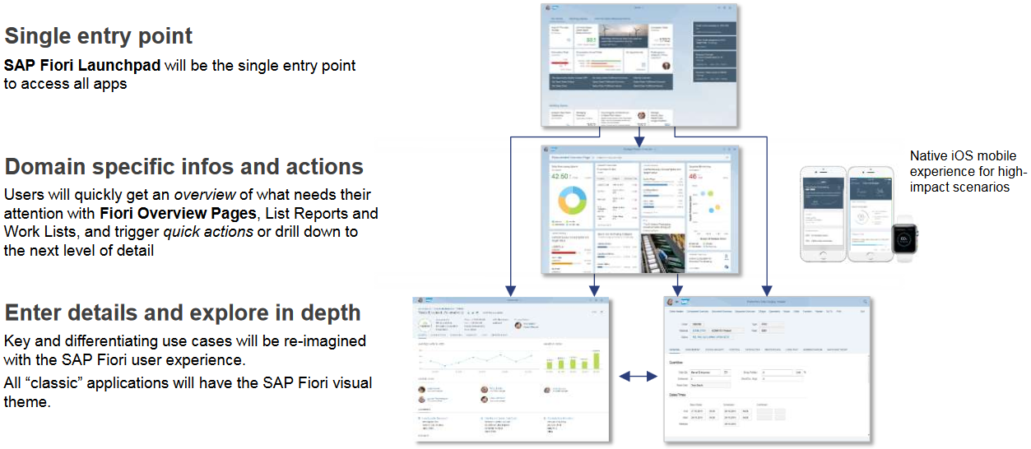
SAP Fiori: The user experience of SAP S/4HANA

Slide 13
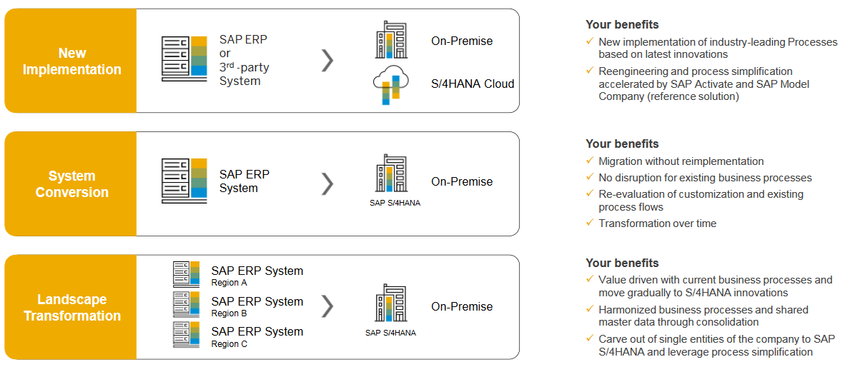
Transition to SAP S/4HANA Three different approaches to move to SAP S/4HANA

Slide 14
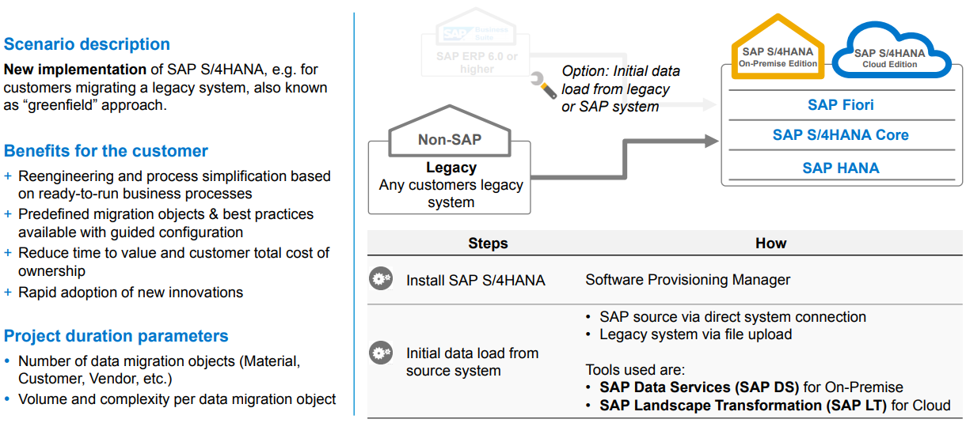
New implementation

Slide 15
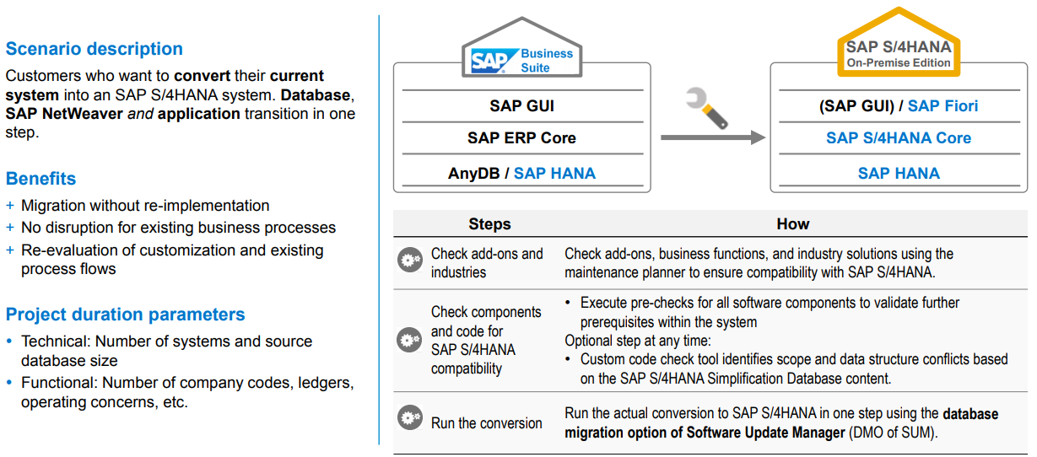
System conversion

Slide 16
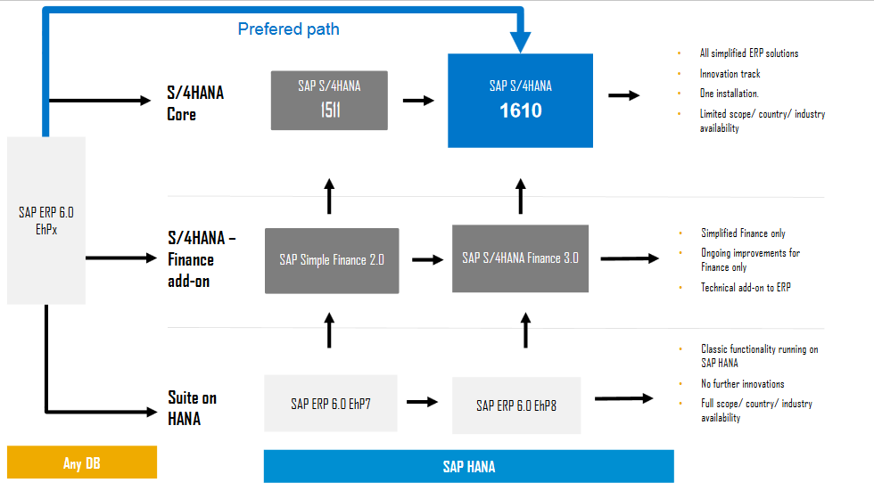
S/4HANA On–Premise Conversion Paths

Slide 17
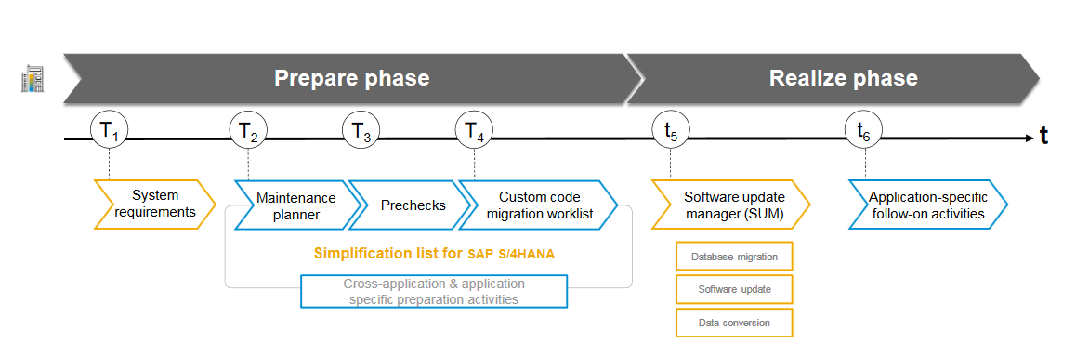
System conversion guided procedure

Slide 18
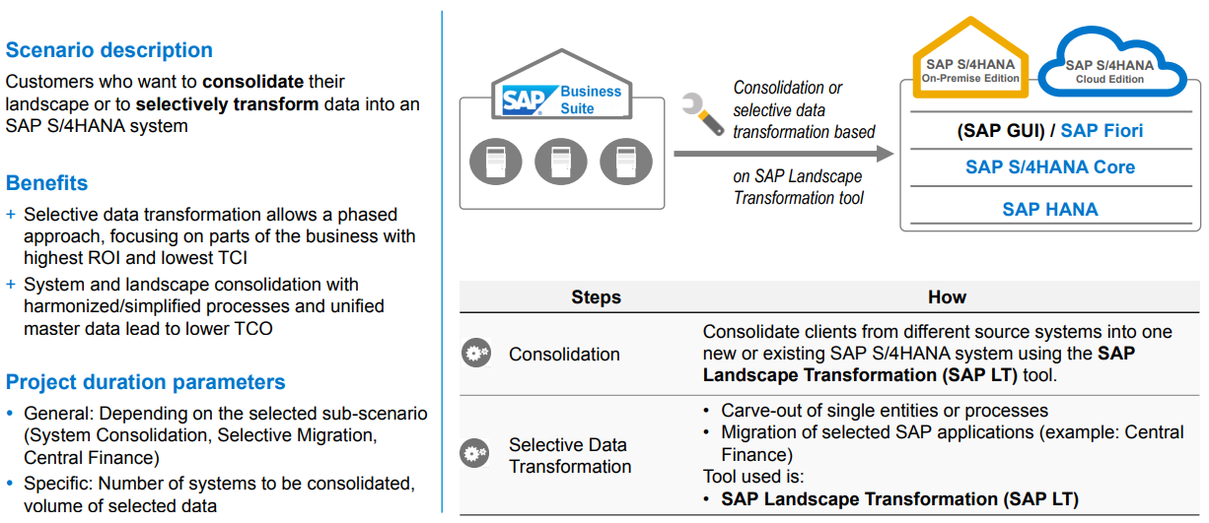
Landscape transformation

Slide 19
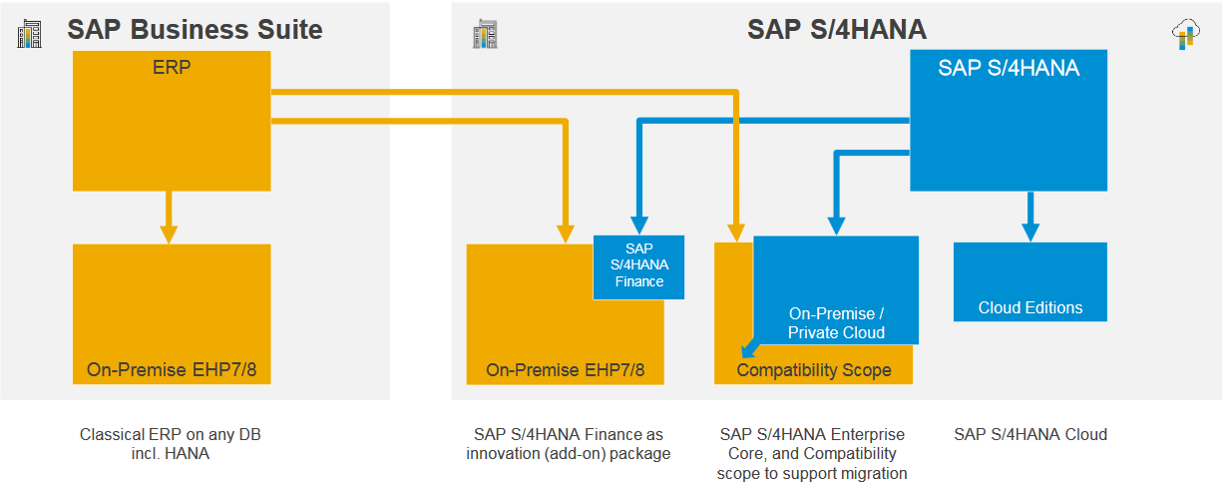
Deployment options understand the difference

Slide 20
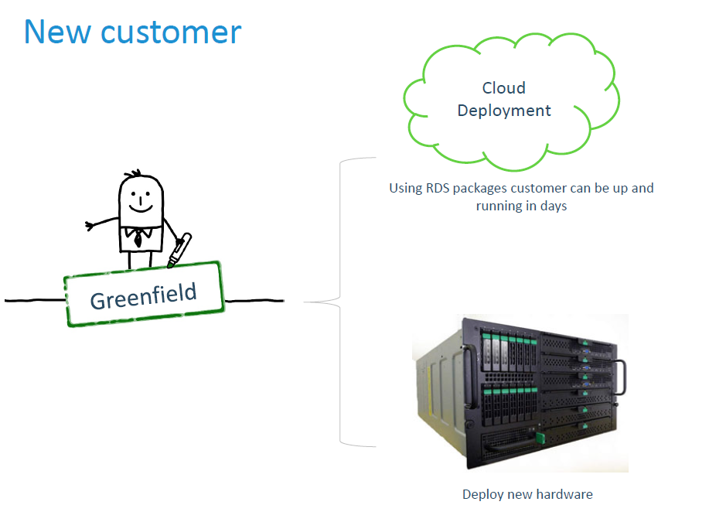
New customer

Slide 21
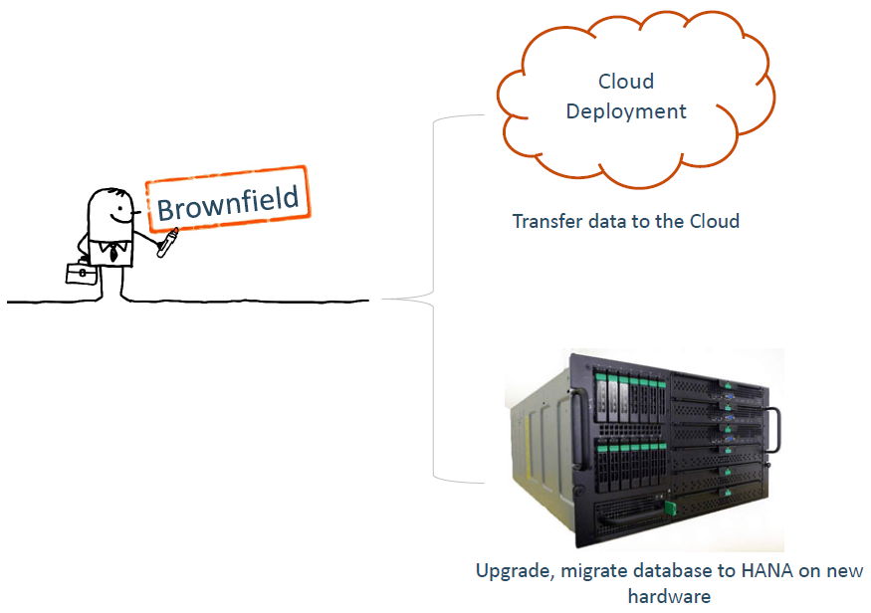
Customer Suite on non-HANA DB

Slide 22
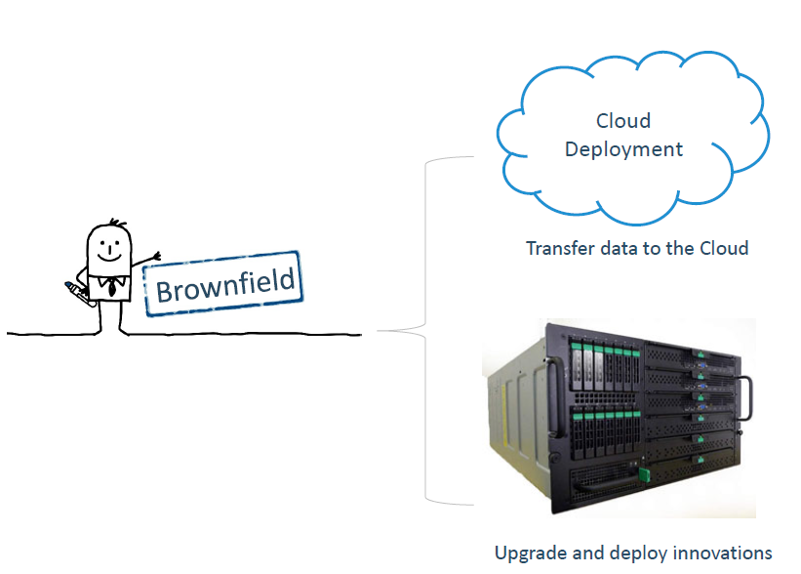
Customer using Suite on HANA

Slide 23
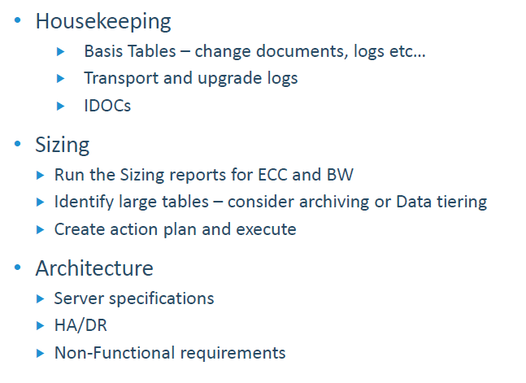
Pre-migration activities

Slide 24
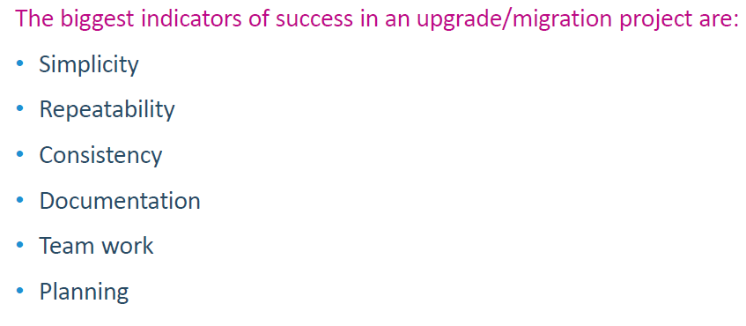
Indicators of success

Slide 25
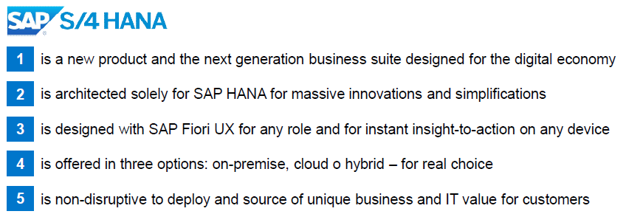
5 Key Points

Slide 26
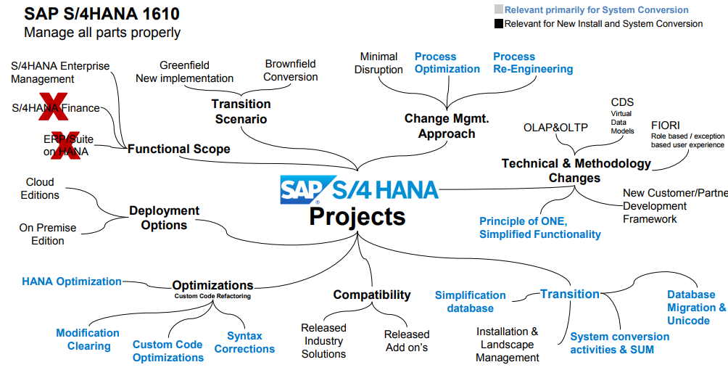
S/4HANA 1610 – a brief info

Slide 27
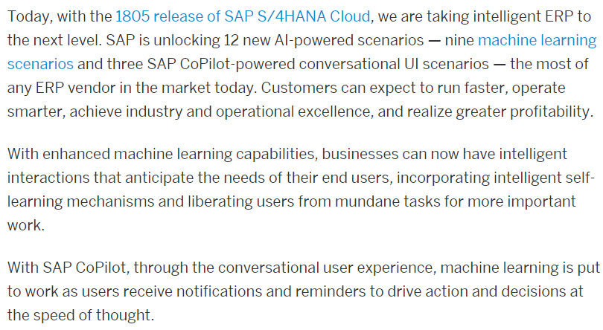
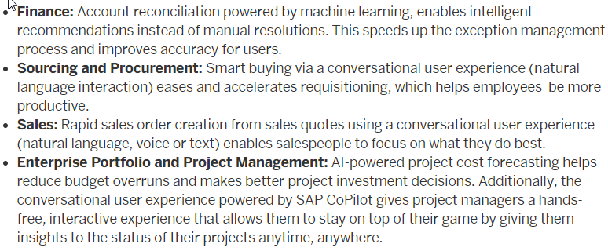
S/4HANA 1805 – A brief info

Slide 28
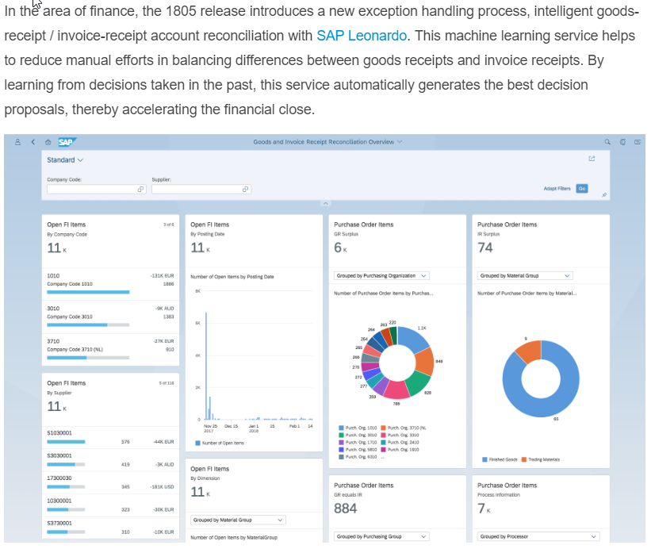
SAP S/4HANA Cloud for Finance
Intelligent GR/IR account reconciliation with SAP Leonardo

Slide 29
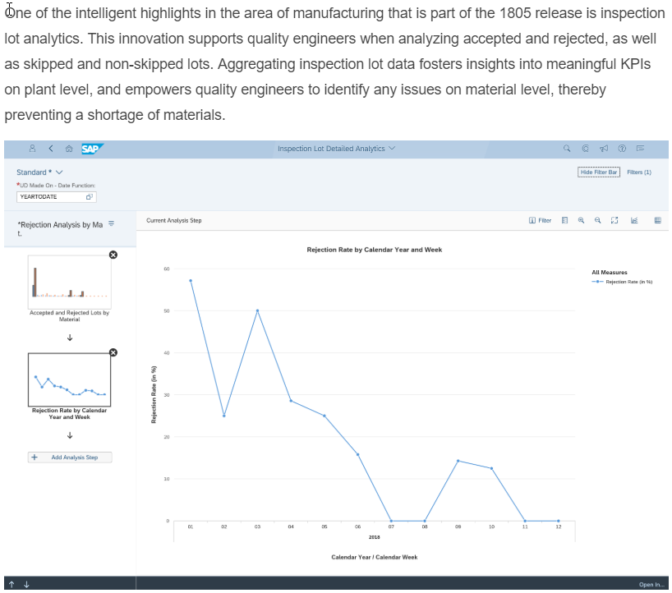
SAP S/4HANA Cloud for Manufacturing
Inspection lot analytics

Slide 30
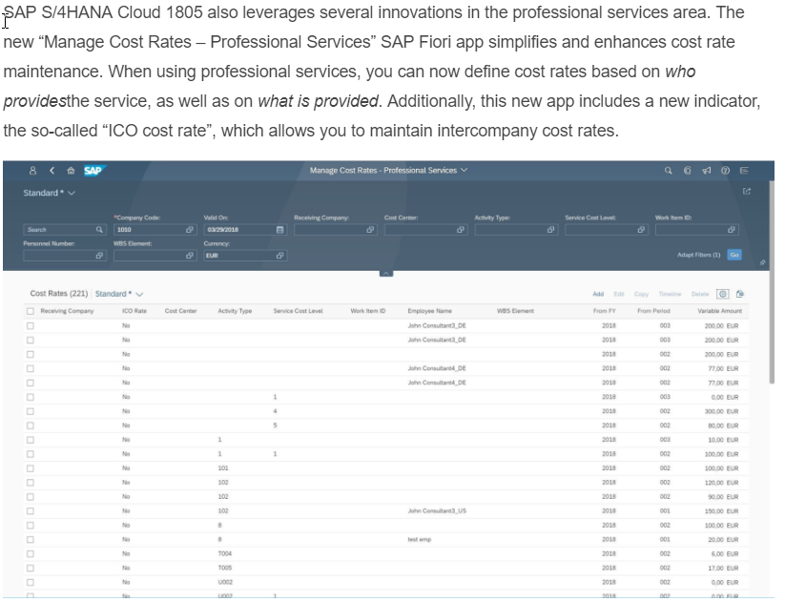
SAP S/4HANA Cloud for Professional Services
Manage Cost Rates – Professional Services app

Slide 31
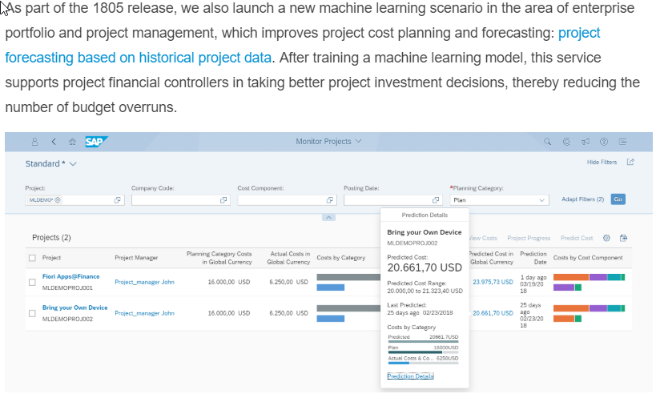
SAP S/4HANA Cloud for Enterprise Portfolio and Project Management
Project forecasting based on historical project data

Slide 32
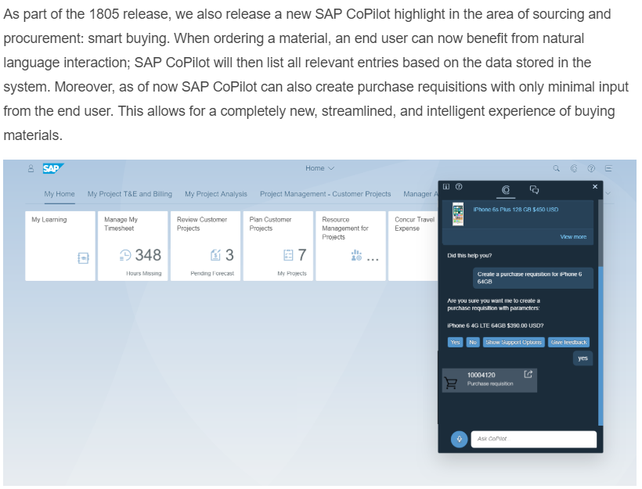
SAP S/4HANA Cloud for Sourcing and Procurement
Smart buying

Slide 33
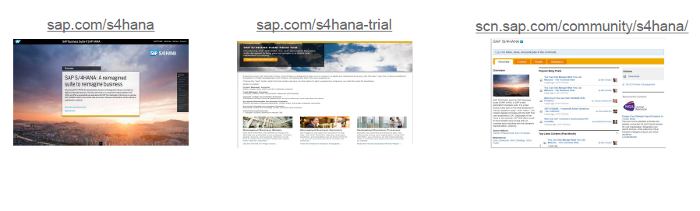
Where to find more information

Slide 34
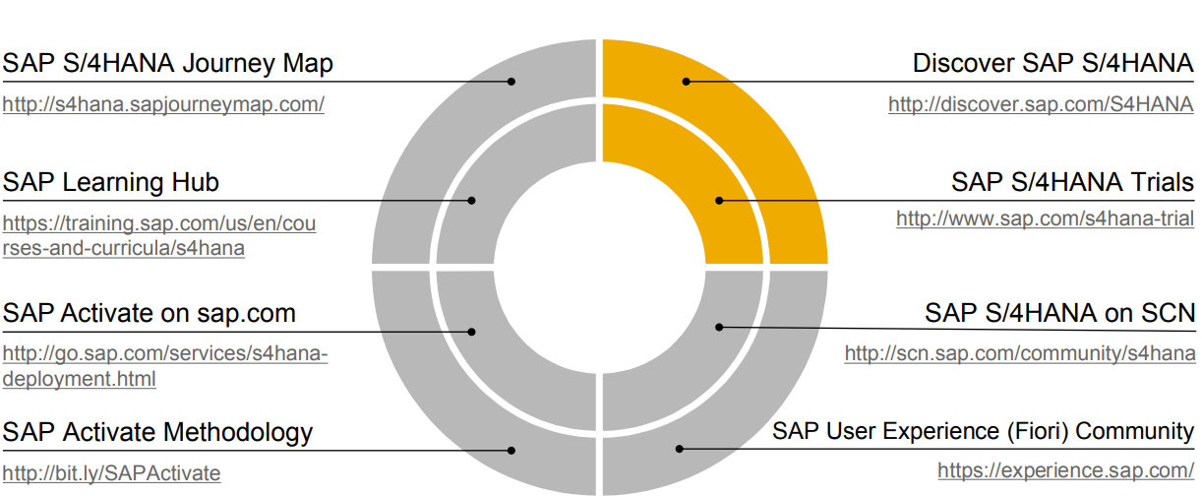
Resources

Slide 35


